Slide 1
An Introduction to Scientific Writing
Dr. Kelsie Endicott

Slide 2
Agenda
Brief introduction
Writing experiences/genre knowledge
Genre activity
Features of academic writing
Section overviews and matching activity
Making connections/transfer
Conclusion

Slide 3
Graduate Writing Center
Dr. Kelsie Endicott, Coordinator of the Graduate Writing Center at UMES
Contact information and location:
kjendicott@umes.edu
https://wwwcp.umes.edu/grad/graduate-writing-center/
EASC 3047
Writers are welcome to make an appointment at any stage of the writing process!
Summer hours of operation:
Monday: 10 a.m. – 1 p.m.
Tuesday: 10 a.m. – 12 p.m.
Wednesday: 2 p.m. – 6 p.m.
Thursday: 4 p.m. – 7 p.m.
Friday: 9 a.m. – 12 p.m.
Saturday & Sunday: CLOSED

Slide 4
What is Music?

Slide 5
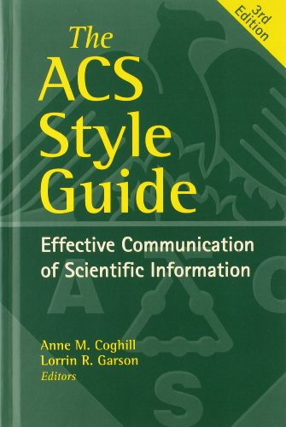
What is a Written Text?

Slide 6
Genres, Genres, Everywhere
Genres exist everywhere! (More examples include but are not limited to things like movies and food).
In their basic conception, genres are types of things. What helps make and define genres are its features, or characteristics.
Thus, we are able to name and identify something as a genre because of its features, or conventions. These features or conventions are generally agreed upon/accepted by most, further cementing its status as a genre.

Slide 7
Sub-genres
Sub-genres function like genres, but on a smaller scale.
Sub-genres are nested, or housed under genres.
Sub-genres are created in much the same way genres are, but are slightly different because we have the advantage of already being familiar enough with the overall or larger genre and our task instead is to identify/create a sub-genre by examining its more specific features or conventions.

Slide 8
Music Activity Part 1
Make a chart with 3 columns. Write down 3 sub-genres/types of music that you like and/or know of.

Slide 9
Music Activity Part 2
Write down features (think descriptors) from each of these sub-genres of music.
Example = Genre: Pop
Features of pop music: repeated chorus, singing, easy-to-remember lyrics…

Slide 10
Music Activity Part 3
In pairs or small groups, share what you came up with.
Next, pick ONE sub-genre from your lists and start writing down its features. Be ready to explain your list to your classmates.

Slide 11
Writing Activity Part 1
Spend a few moments writing down all of the different types/sub-genres of writing that you’ve done.

Slide 12
Writing Activity Part 2
Now, spend a few moments writing down all of the different types/sub-genres of writing that you know of.

Slide 13
Writing Activity Part 3
In pairs or small groups, share your lists with each other.
Write down two new lists, one should be titled “Sub-genres of Writing We’ve Done” and the other should be titled, “Sub-genres of Writing We Recognize.”
Groups should be prepared to share their answers with the class.

Slide 14
Writing Activity Part 4
Next, we’ll create two master lists of all of the sub-genres of writing that we, collectively as a class have done, and all of the sub-genres of writing we recognize.

Slide 15
Genres can be Nested
Music
Pop
Rap
Rock
Classical
R&B
Country
Writing
Poetry
Fiction
Non-fiction
Romance
Historical Fiction
Academic Writing

Slide 16
Focusing on the Sub-genre of Academic Writing
What is academic writing? We know it’s a sub-genre, but what exactly is it? What are some of its features/conventions/descriptors?
In pairs or small groups, discuss and take note of features of academic writing.
Once you’ve identified some features of academic writing, make a list titled “Features of Academic Writing” and list these features. Be prepared to explain your list to your classmates.
Finally, we will make a master list of the features of academic writing that we’ve identified.

Slide 17
Understanding Academic Writing
Features
Formal tone
Sophisticated/formal language
Types of Texts
Essays
Lab reports
Purposes (exigence)
Informative
Journal articles
Theses
Dissertations
Book reviews
Explanatory
Argumentative/Persuasive
Identify
Prove/offer proof
Educate
Create new theories
Additive
Solution-oriented
Research papers
Proposals
Presentations
Follows a style guide (ACS, APA, MLA, etc.)
Disciplinary language
Uses hedging language (perhaps, suggest, indicate, etc.)
Tables, figures, charts, graphs
Citations/References
Data
Claims supported by evidence
Structured/formulaic
Section headings

Slide 18
Course-specific Types of Texts
Lab reports
Research papers
Journal articles
Presentations
Theses or Dissertations

Slide 19
Adopt an IMRAD Approach to Writing
I = Introduction
M = Materials and Methods
R = Results
A = and
D = Discussion

Slide 20
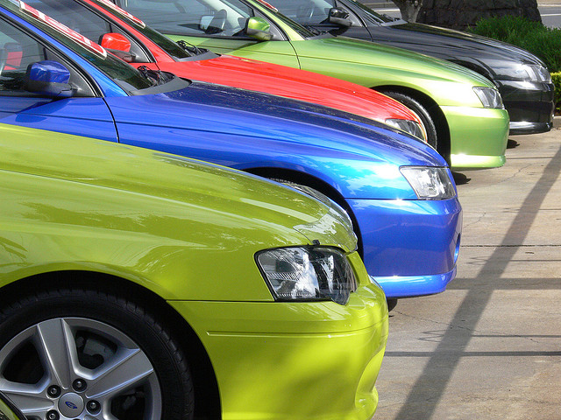
Introduction: Make a case for your research
The introduction explains why this research is important or necessary or important.
Begin by describing the problem or situation that motivates the research.
Move to discussing the current state of research in the field; then reveal a “gap” or problem in the field.
Finally, explain how the present research is a solution to that problem or gap.
If the study has hypotheses, they are presented at the end of the introduction.
CARS is a helpful acronym. Create a Research Space

Slide 21
Materials and Methods: What did you do?
The methods section tells readers how you conducted your study.
It includes information about your population, sample, methods, and equipment.
The “gold standard” of the methods section is that it should enable readers to duplicate your study.
Methods sections typically use subheadings; they are written in past tense, and they might use passive voice.

Slide 22
Results: What did you find?
In this section, you present your results/findings.
Typically, the Results section contains only the findings of the study, not any explanation of or commentary on them.
Results sections are usually written in the past tense.
Make sure all tables and figures are labeled and numbered separately.

Slide 23
Discussion: What does it mean?
In this section, you summarize your main results/findings, comment on them, and connect them to other research.
You might also discuss limitations of your study, and use these limitations as reasons to suggest additional, future research.

Slide 24
Other Common Sections of Research-related Reports
Abstract: Summarizes the entire study
The abstract for the report comes at the beginning of the paper, but you should write it after you have drafted the full report.
The abstract provides a very short overview of the entire paper, including a sentence or two about the report’s purpose and importance, a sentence or two about your methods, a few sentences that present the main findings, and a sentence or two about the implications of your findings.
Conclusion: Where you wrap up your ideas and leave the reader with a strong final impression.

Slide 25
Activity: Match sections of a research-based report to their headings
In small groups, work together to correctly identify the different sections of a research paper to their corresponding section header.
There are 5 sections (abstract, introduction, materials and methods, results, and discussion).

Slide 26
Strategies for Writing in New Genres
Use your prior genre knowledge and writing experiences to figure out if they are transferable to the current writing assignment.
Use a mentor text/model text to help you write.
Take an inventory of your writing resources. What tools, websites, books, people, can help you gain a better understanding of the type of writing you are working on.

Slide 27
Downshifting
Spend a few moments writing down any connections you see between different genres and sub-genres of writing you’ve done before and how they may be transferable/applicable to the research-based academic writing you are expected to do in this course.

Slide 28
Thank You!
Dr. Kelsie Endicott, Coordinator of the Graduate Writing Center at UMES
kjendicott@umes.edu
https://wwwcp.umes.edu/grad/graduate-writing-center/

